Slide 1
UD Reporting
Where Are We Now
Where Are We Going
How Do We Get There

Slide 2
Where are we now
Cognos Reports
1 UD RBB
Financial
HR
Student
1 UD Student Admin Reports
AA Deans
Admissions
Schedule of Class (SOC)
1 UD Course and Workload Verification

Slide 3
1 UD RBB
Reports to support RBB
Report definitions found on http://www.udel.edu/IR/UDEW/
Data pulled from
Student Enrollment Data Mart
PeopleSoft Financial
PeopleSoft Human Resources

Slide 4
Institutional Research

Slide 5
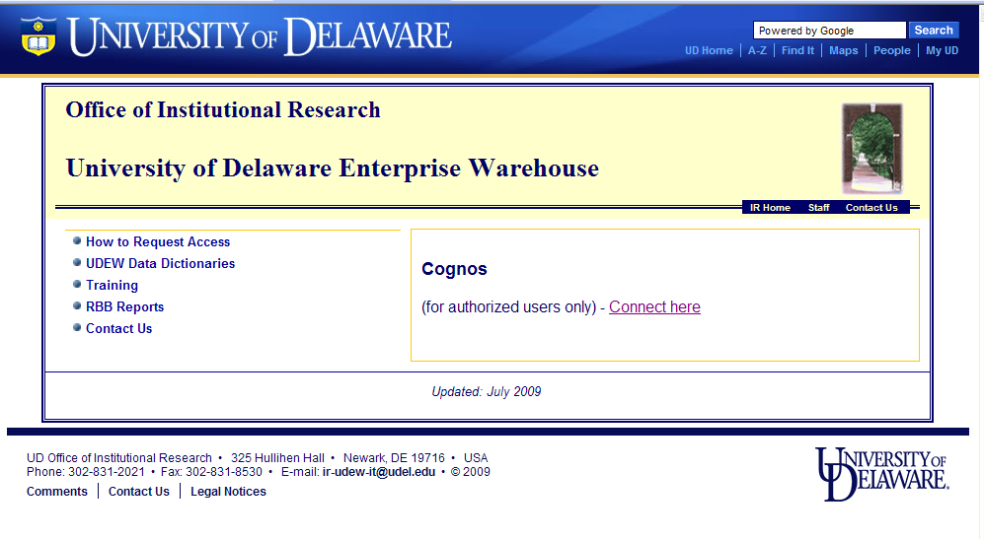
UD Enterprise Warehouse -UDEW

Slide 6
Cognos Connection

Slide 7
1-RBB Folder

Slide 8
Financial Reports

Slide 9
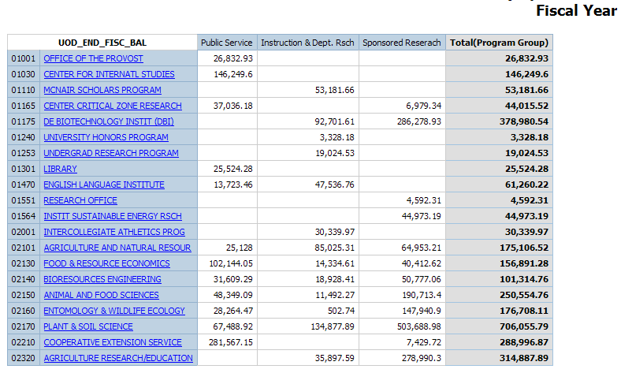
Externally Sponsored Activities

Slide 10
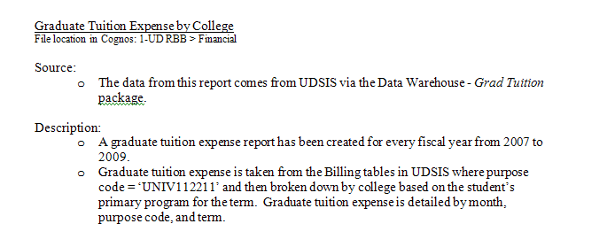
Grad Tuition Expense by College

Slide 11
Graduate Tuition Expense by College By Academic Plan

Slide 12
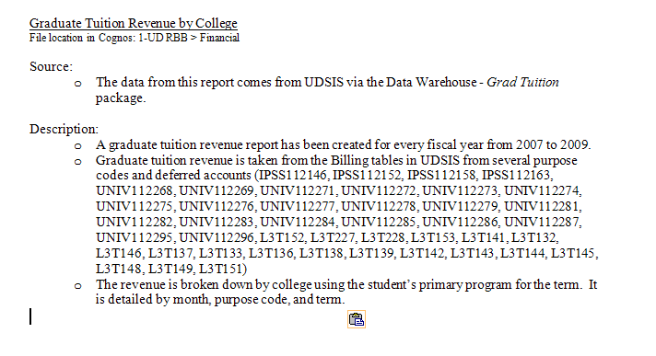
Graduate Tuition Revenue By College

Slide 13
Graduate Tuition Revenue By College By Academic Plan

Slide 14
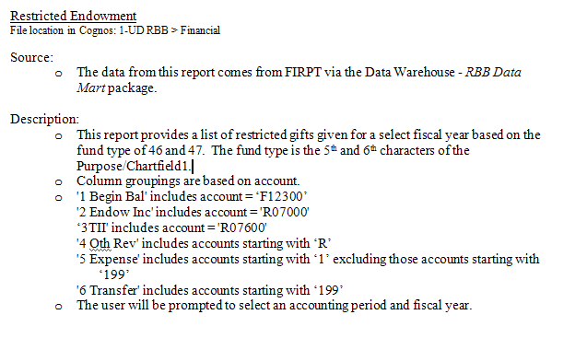
Restricted Endowment

Slide 15
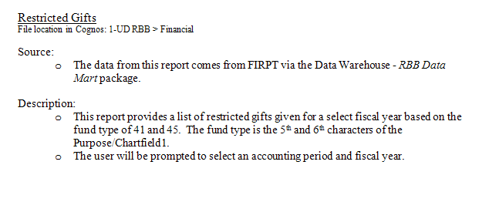
Restricted Gifts

Slide 16
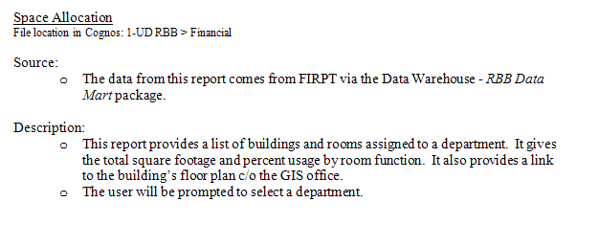
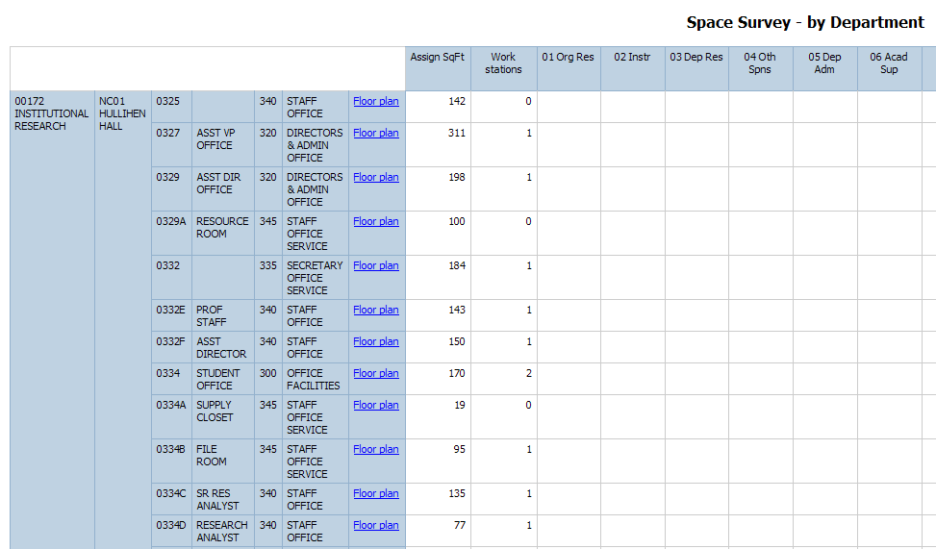
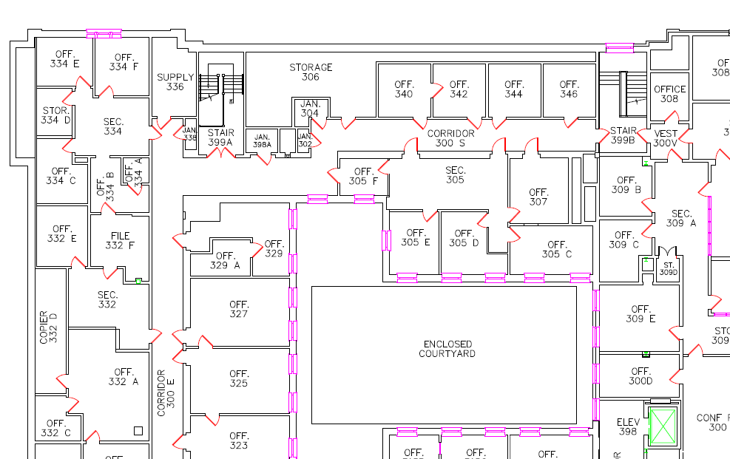
Space Allocation

Slide 17
HR Reports

Slide 18
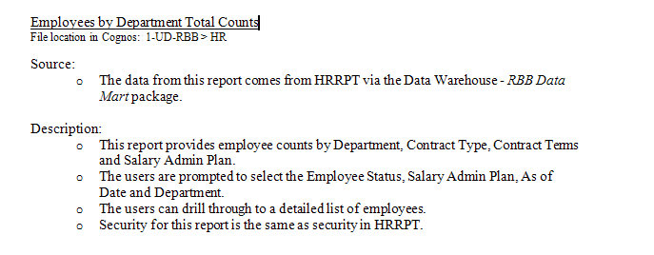
Employee By Department Counts

Slide 19
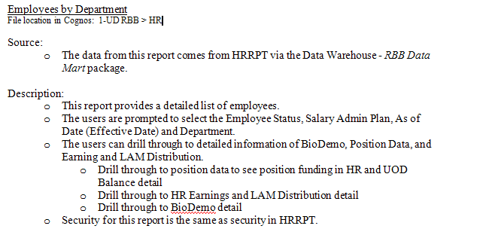
Employees By Department

Slide 20
Drill to Bio Demo

Slide 21
Drill to HR Earnings and LAM

Slide 22
S Contract

Slide 23
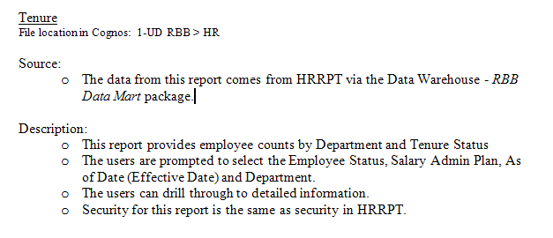
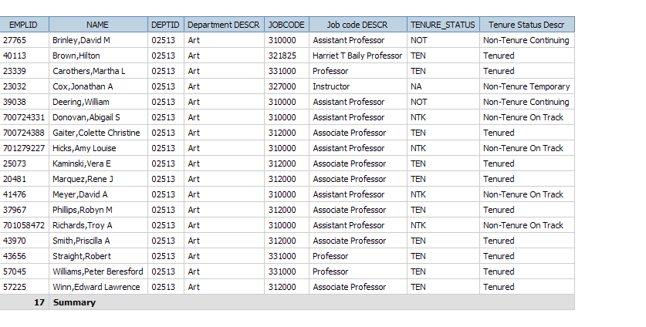
Tenure

Slide 24
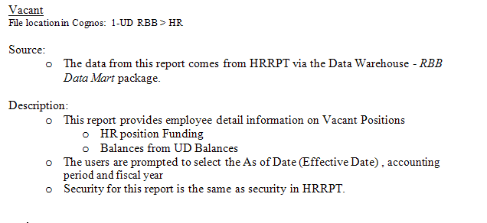
Vacant Positions

Slide 25
Student

Slide 26
Student > RBB Reporting

Slide 27
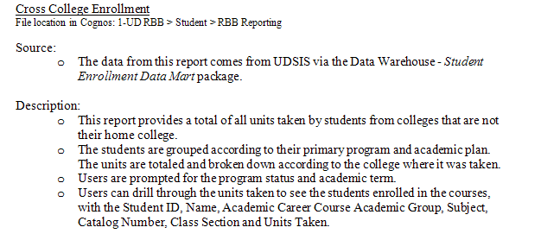
Cross College Enrollment Graduate Students

Slide 28
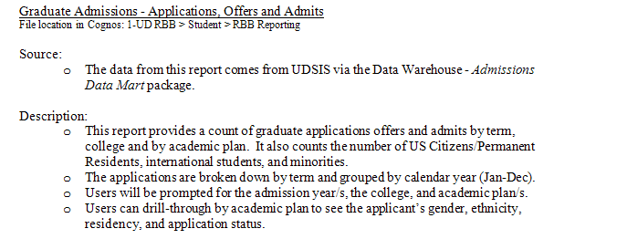
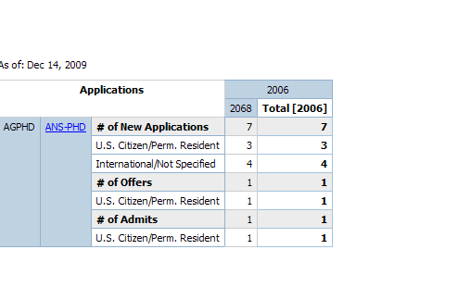
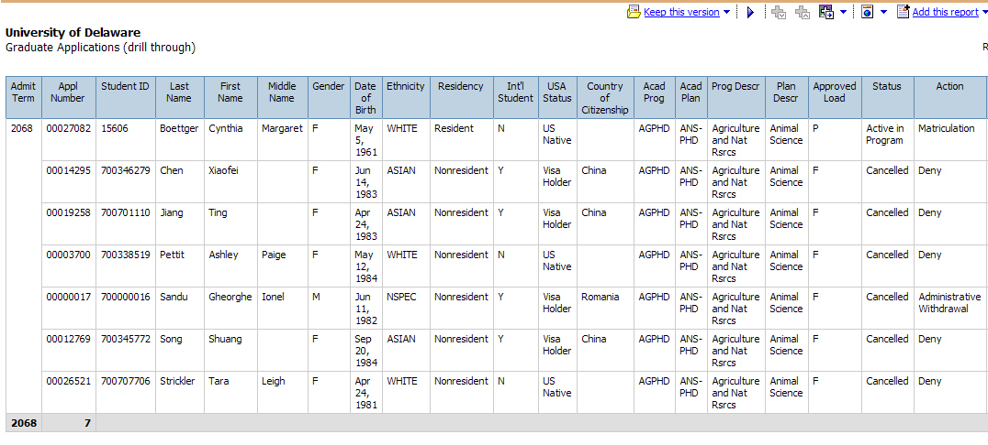
Graduate Admissions Applications, Offers and Admits

Slide 29
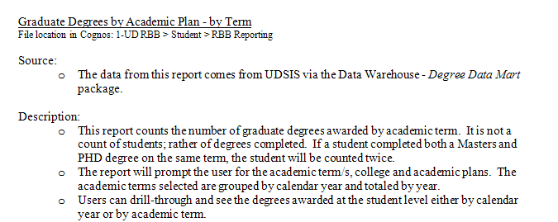
Graduate Degrees by Academic Plan by Term

Slide 30
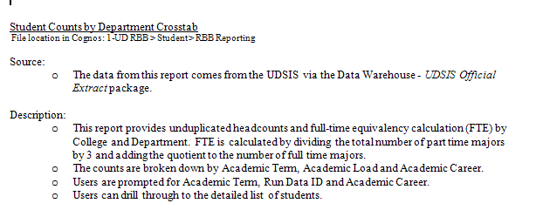
Student Counts by Department

Slide 31
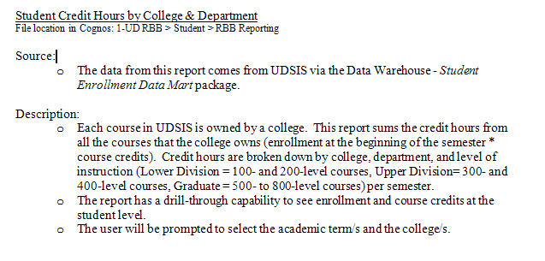
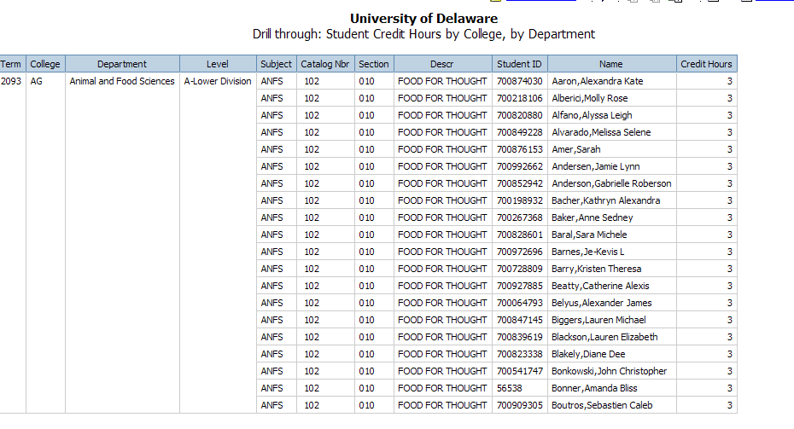
Student Credit Hours by College and Department

Slide 32
ICOR
Instructor College of Record
Based on Student’s enrollment
Overload(paid by S-Contract)
College paying based of speedtype
If payer not College
Instructor home department in HR
If not in College
Owner of the course
Regular Load
Instructor home department in HR
If not in College
Owner of the course

Slide 33
Issues Reporting ICOR
Instructor
Missing instructor data
Incorrect workload
Pulling data from multiple systems
S-Contract
Course may be missing/incorrect in HR
Rolling up to College level
Not available in HR yet
Security
HR for Instructor home department
FIN for purpose/chartfield1

Slide 34
1 UD Course and Workload Verification
Report to validate instructor and workload
Required to allow accurate ICOR reporting

Slide 35
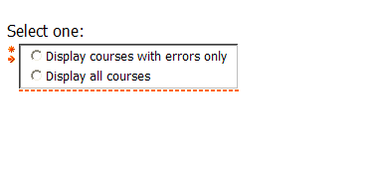
Required Parameters

Slide 36
Course Verification

Slide 37
1 UD Student Admin
Reports to support Academic Management
Reports created by various report writers
Institutional Research
Registrar Office
Schedule of Classes
Limited access to sensitive data
Grades
GPA
Admissions

Slide 38
Where We Are Going
Fully Integrated Data Warehouse
Seamless reporting from UDSIS, Financial and HR
Student Tracking System
Changes in Careers
Changes in Programs/Colleges
Changes in Plans/Majors
Persisters
Time to degree
Reports
Dashboards and Scorecards

Slide 39
How Do We Get There
Fully Integrated Data Warehouse
Verification of data in Financial and HR data marts
Requires commitment from UD for testing
Realistic testing plan based on user availability
Commitment to address data and design issues
Commitment from IT to support modifications, technical, and hardware issues

Slide 40
Student Tracking and Persisters
Currently under development
Commitment from
Institutional Research
Registrars Office
IT

Slide 41
Reporting Concerns
Implementation of Data Warehouse
Data integrity
Data Definitions
Data governance committee
Security Issues
HR
Financial
Report vs. Data
Standardizing reports across campus
Decision Support System translating data into information.
Access to Raw Data
Input of report design
Dashboards and Scorecards
Monitor and chart progress.
Training
Power users vs. canned report users/viewers
Few power users but require more training

Slide 42
Questions ?
Office of Institutional Research
Phone: 302-831-2021
www.udel.edu/IR
Kat Collison
Data Warehouse Manager
E-mail:
katc@udel.edu
ir-udew-it@udel.edu
12/15/2009

